Slide 1

Madhav Store Online Sales Dashboard
Tracking and Analyzing Online Sales Across India-
Presented by: Harsh Bopaliya
Date: 7/11/2024

Slide 2
Introduction
Project Overview:
Purpose: To create a Power BI dashboard for Madhav Store to track and analyze their online sales.
Objectives:
Provide insights into sales performance across regions.
Identify trends and patterns in online sales.
Find most Profit Month and Quarter
Assist in strategic decision-making for marketing and inventory management.
2

Slide 3
Data Source
Data Description:
Source: Data collected from Madhav Store's online sales records. Two Csv files Details.csv And Order.csv.
Data Fields:
Details.csv: Amount,Category,Order ID , Payment Mode,Profit,Quantity,Sub-Category.
Order.csv : City ,CustomerName , Order date , Order ID, State
Data Preparation:
Data cleaning and transformation steps.
Handling missing values and duplicates.
Correct Date Formate of Order date.
Add New Column AOV Using This Formula AOV= [Amount]/[Quantity]
3

Slide 4
Power BI Dashboard Overview
Dashboard Overview:
The Power BI dashboard for Madhav Store's online sales provides a comprehensive view of their sales performance across India. It includes key sections such as Sales Overview, Regional Sales Performance, Product-wise Sales Analysis, Sales Trends Over Time, and Customer Insights.
Regional Sales Performance uses interactive maps and charts to visualize sales distribution across different states, helping to identify top-performing regions and regional trends.
Product-wise Sales Analysis details sales by product categories, pinpointing top-selling items and trends in consumer preferences.
Features and Benefits:
The dashboard offers interactive filters for easy data exploration by region, product category, and time period. Users can drill down from high-level summaries to detailed insights with just a few clicks, facilitating deeper analysis and decision-making.
Its purpose is to empower strategic decisions in marketing, inventory management, and customer engagement by providing real-time updates and actionable insights. The user-friendly interface ensures a seamless experience, enabling stakeholders to navigate and interpret data effortlessly, thereby enhancing operational efficiency and performance monitoring for Madhav Store.
4

Slide 5

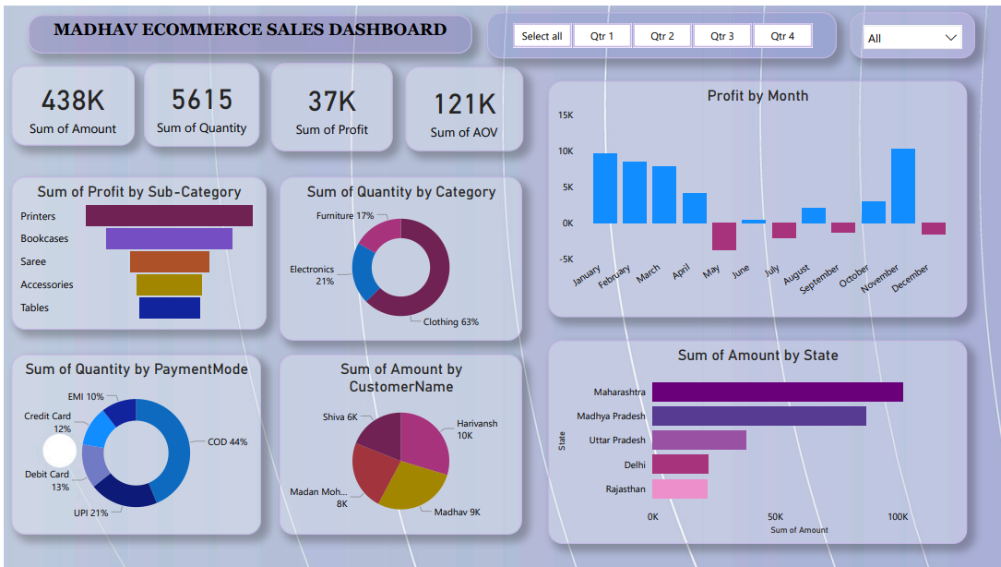
MADHAV ECOMMERCE SALES DASHBOARD
To track and analyze online sales performance across India for Madhav Store using a Power BI dashboard.
10
5

Slide 6
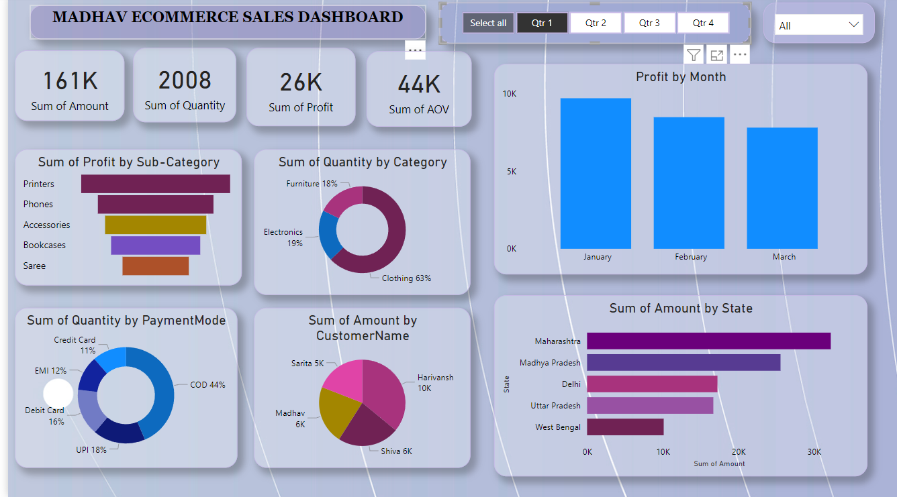
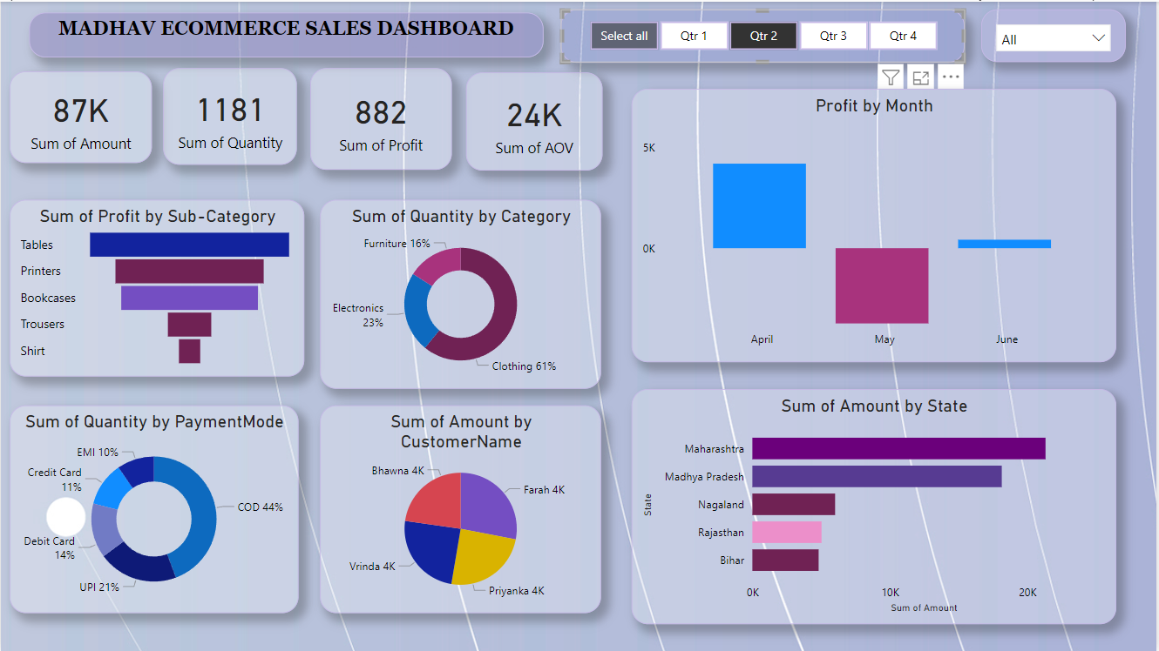
For Qtr1
For Qtr2
6

Slide 7
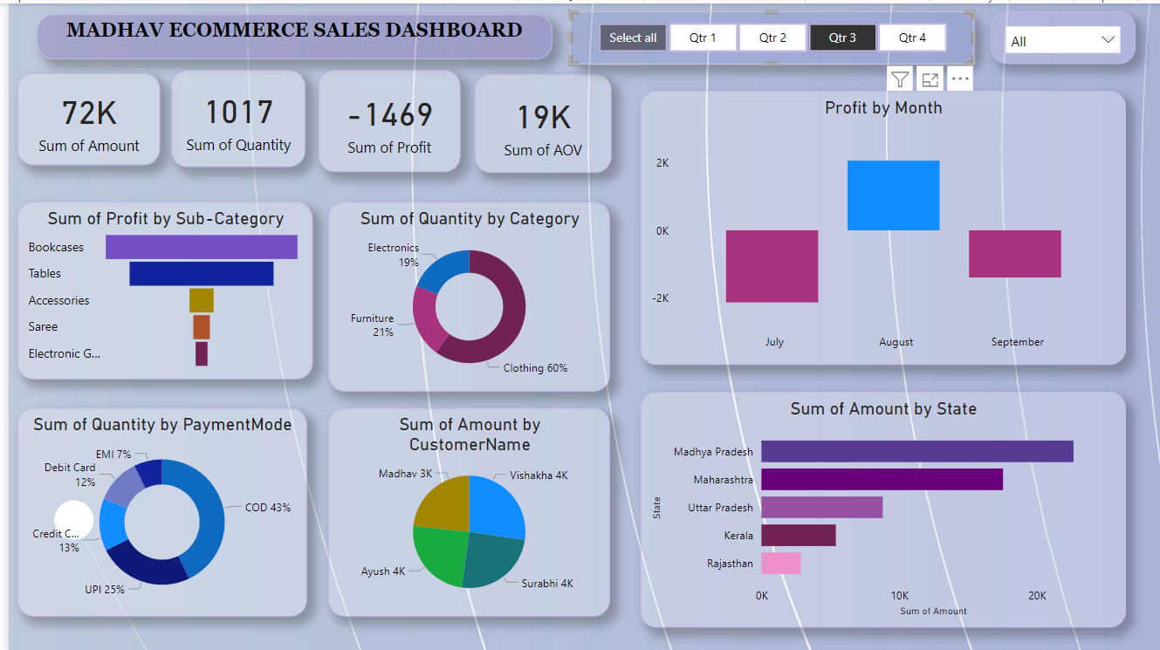
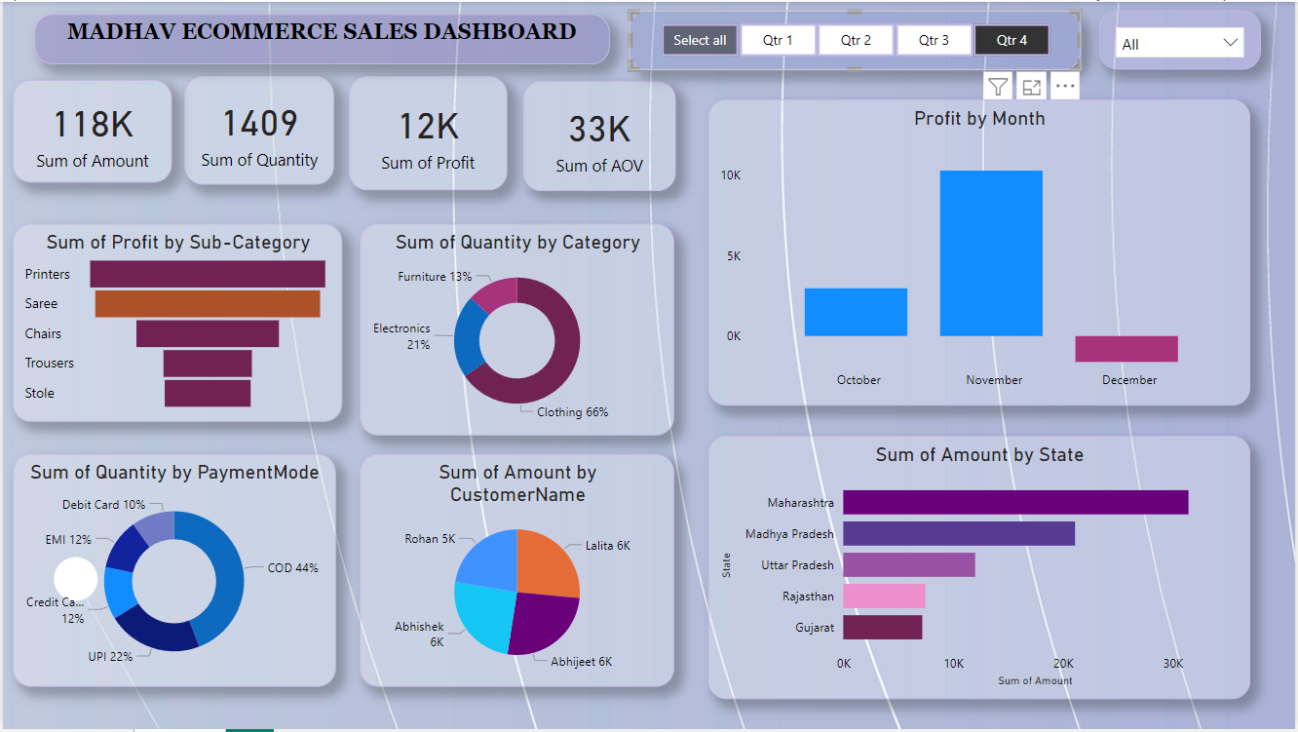
For Qtr3
For Qtr4
7

Slide 8
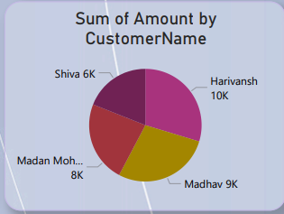
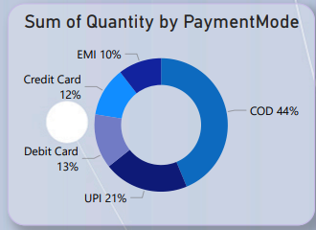
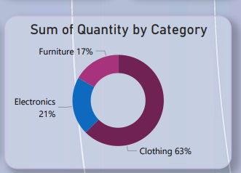
Customer Insight
Top States by Frequency of Purchases: Maharashtra, Madhya Pradesh, Uttar Pradesh, and Gujarat.
Top Customers: Hativansh, Madhav, Madan Mohan, and Shiva.
Most Purchased Product Category: Clothing.
Highest Profit Month: November.
Top Sub-Categories by Profit: Printers, Bookcases, Sarees, Accessories, and Tables.
Preferred Payment Mode: 44% of transactions are Cash on Delivery (COD).
Sum of Amount by
Customer Name
Sum of Quantity
by PaymentMode
Sum of Quantity
by Category
9

Slide 9
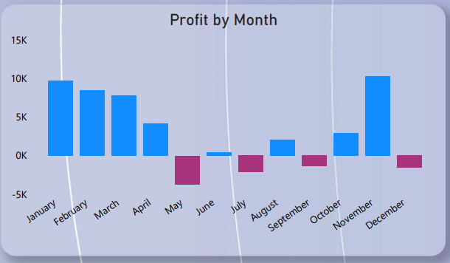
Sales Trends Over Time
In May, July, September, and December, the profit was lowest due to negative values.
Key Financial Metrics for All Quarters:
Total Amount: 432K
Total Quantity Sold: 5,615 units
Total Profit: 37K
Average Order Value (AOV): 121K
10

Slide 10

Conclusion
Summary of Insights:
Sales Performance: Maharashtra has the highest sales performance.
Seasonal Trends: November recorded the highest profit of the year, and the first quarter achieved the
highest cumulative profit.
Customer Insights: Most Buy prod
Recommendations:
Marketing Strategies: Implement targeted promotions, seasonal marketing campaigns, product bundling, and
enhanced advertising to boost sales in May, July, September, and December.
Inventory Management: Optimize stock levels based on the high sales performance of clothing and
profit trends of printers.
Customer Engagement: Implement targeted campaigns to enhance customer retention during
low-profit months like May, July, September, and December.
Next Steps:
Continuous Monitoring: Regularly update and monitor dashboard insights.
Expansion: Include additional data sources for deeper analysis.
Training: Provide training for stakeholders to maximize dashboard utilization.

